Slide 1

QORVO_RADIO
Prototype Status Review
02/10/2025
Andrew Nicola, Nathan Waters, Andrew Bowman, Alan Luecke, Steve Freinstein
Notes:
Introduce entire team

Slide 2

Objective [A] [B]
Primary goal
Design and Develop a modular, reconfigurable Software Defined Radio (SDR) platform that can accommodate future student projects and provide a flexible environment
Key Functionality
Enable testing of multiple RF modules simultaneously with an independent digital control
Support a frequency range of 85 MHz to 2500 MHz with dual receive (Rx) channels
Ensure interaction between hardware and software through an Ethernet/USB interface
Information from [C] Statement of Work
Notes:
Go over SOW/ what we are doing for project

Slide 3
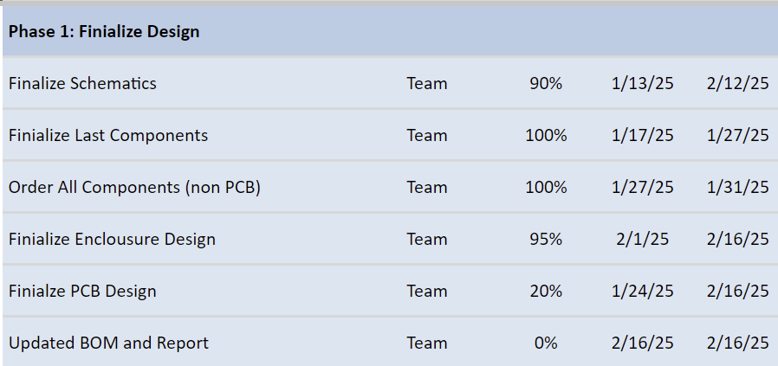
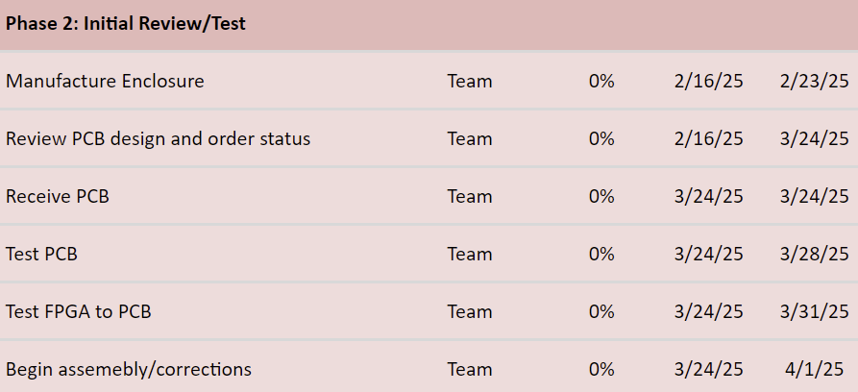
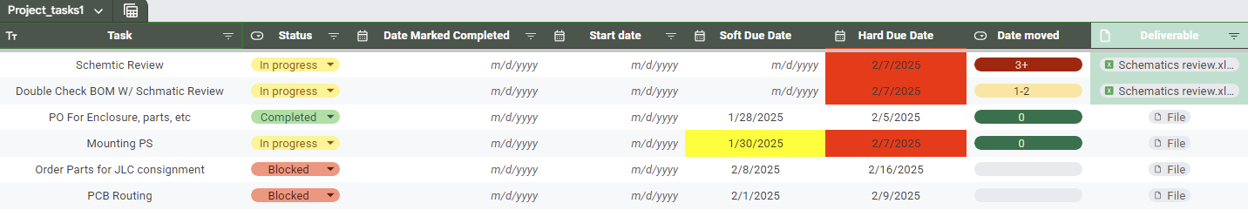
Project Plan and outstanding milestones [B]
Notes:
Go over SOW/ what we are doing for project

Slide 4
Purchase Status [J] [K] [P1.3]
PR3 (Amazon), and PR4 (Digikey) (P1.3 of Project Plan)
Both have been approved and are currently being ordered by ISL
PR3 Lead Time is 5 days (All items)
PR4 Lead Time is 1 week (All items)
These PRs include all remaining hardware, connectors, and non-PCB items
Waiting on:
PCB completion for order through JLC PCB
Once Final Schematic is reviewed, consigning order with JLC will be ordered
Notes:
Go over SOW/ what we are doing for project

Slide 5
System Model Status
PCB
Changes mostly added to Schematic
Block Diagram almost complete (Need to figure out controls)
Review then Layout
Software
Initial testing of Eclypse Z7 with GNU Radio is in progress
Working on Verilog/VHDL code and verification
SPI controllers are functional within simulations, but require improvements.
Will need to simulate passing of GNU Radio data
Enclosure
All enclosure components with new dimensions and parts are updated in CAD.
Walls are ready for 3D printing, and the base plate and lid are ready for drilling/cutting.
Notes:
Go over SOW/ what we are doing for project

Slide 6
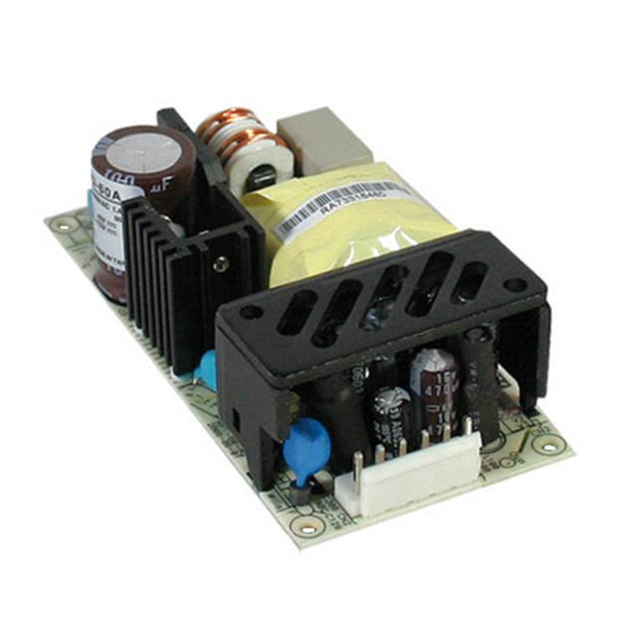
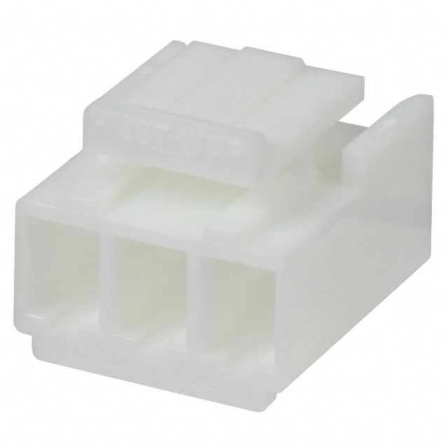
Power Supply [K]
Switched to the RPD-60A power supply due to the cost and size of the previously agreed on power supply.
Medical grade switching power supply with 5V and 12V outputs, rated for 50W and has a 100 kHz Frequency of oscillation.
Will need to make our own AC power cable that goes from the enclosure to the AC input.
Cable will have three inputs: live, neutral and ground.
Notes:
Go over SOW/ what we are doing for project

Slide 7
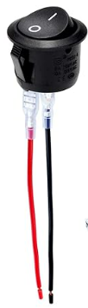
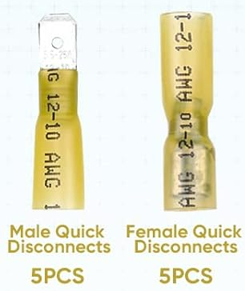
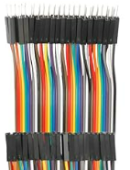
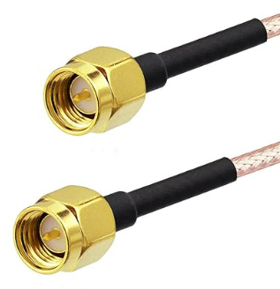
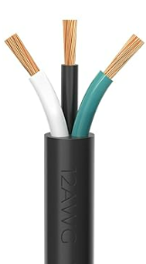
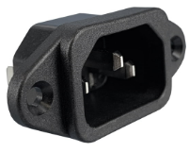
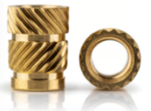
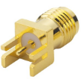
Hardware/connectors Progress [J] [K] [P1.3]
Recommended receptacle is compatible with wire gauges of #22 - #16, we will be using #12 wire. We will crimp a quick disconnect directly to the pin, and then crimp our wire to that.
Power Entry Receptacle for power transmission from wall outlet to power supply
On/Off power switch for FPGA mounted to exterior of enclosure
7.8 inch jumper wires for testing, FPGA/PCB communication
SMA male - male for PCB - ADC connection
SMA female edge connector for PCB
Threaded heat inserts and hardware for enclosure
Link
Link
Link
Link
Link
Link
Notes:
Go over SOW/ what we are doing for project

Slide 8
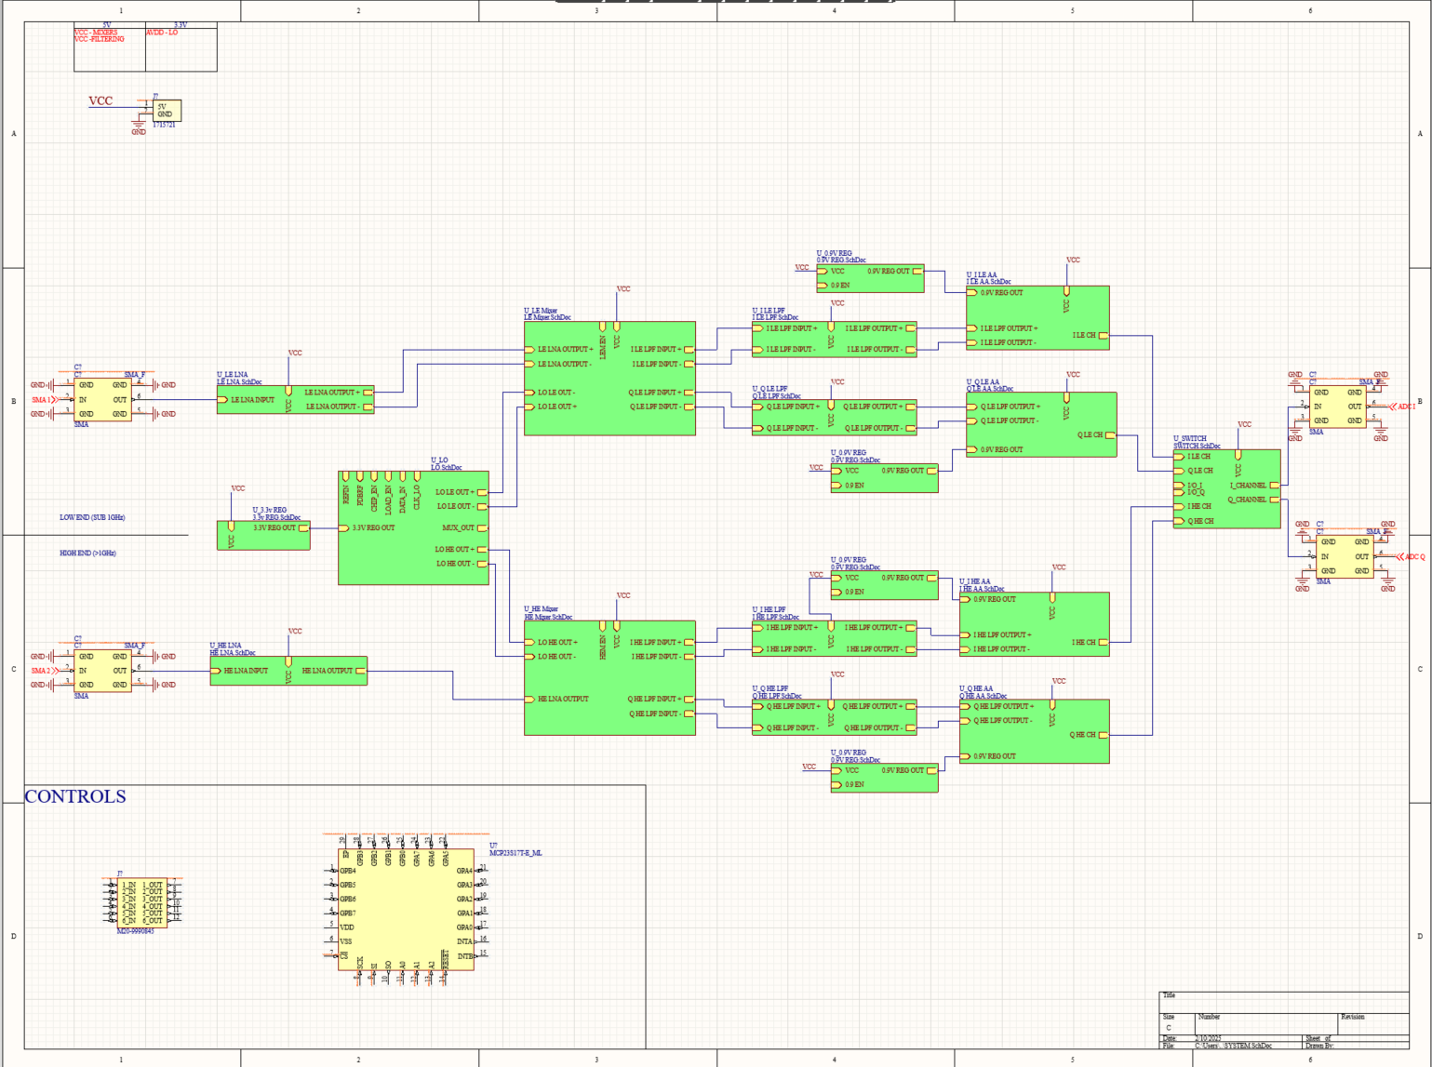
Schematic Changes
Test points
Controls
Power
GND pin for testing
Important Nets Labeled
Filtering Split up
Board Stackup
System level Block Diagram is almost complete
All RLC footprints attached
Notes:
Go over SOW/ what we are doing for project

Slide 9
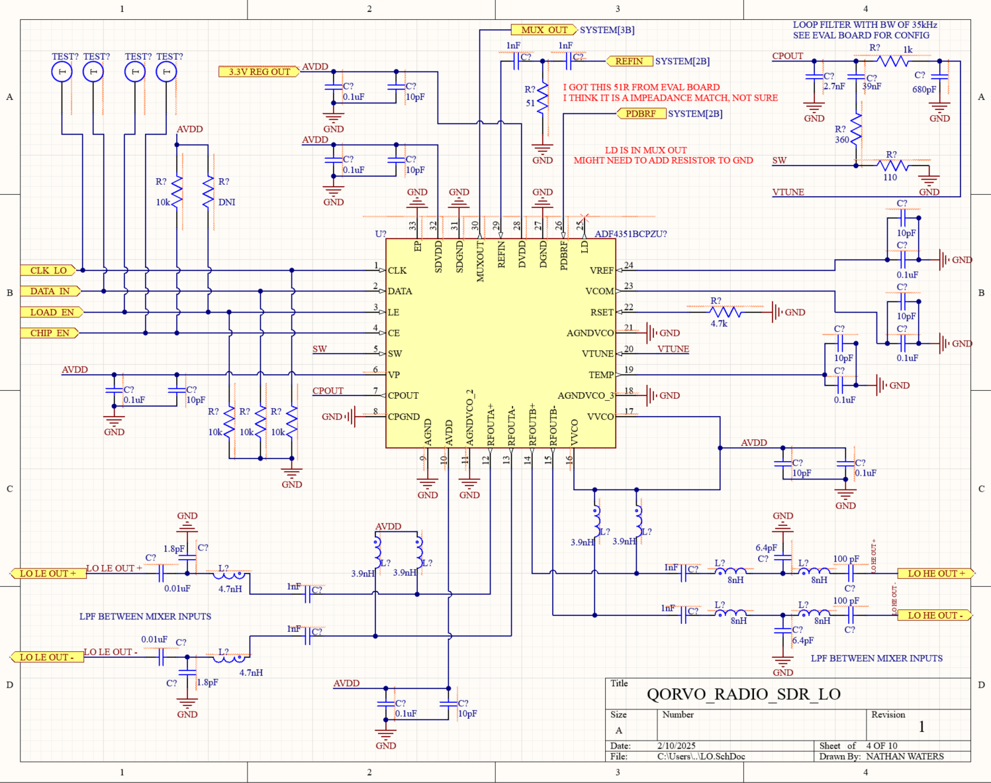
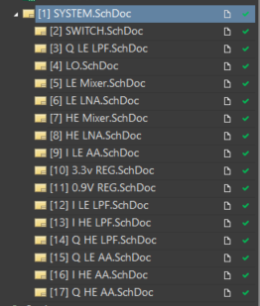
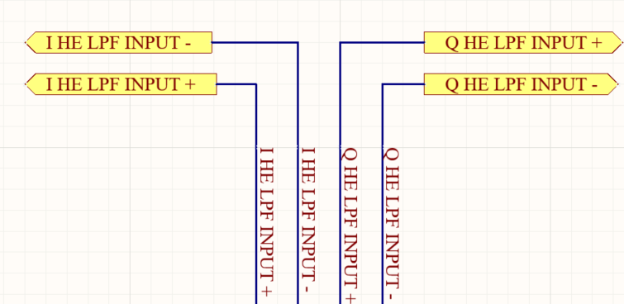
Schematic/Changes
Notes:
Go over SOW/ what we are doing for project

Slide 10
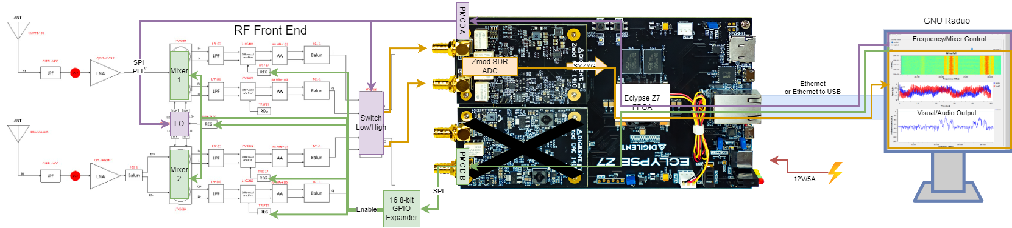
Abstracted Data Path [G] [P1.1, 1.6]
Notes:
Go over SOW/ what we are doing for project

Slide 11
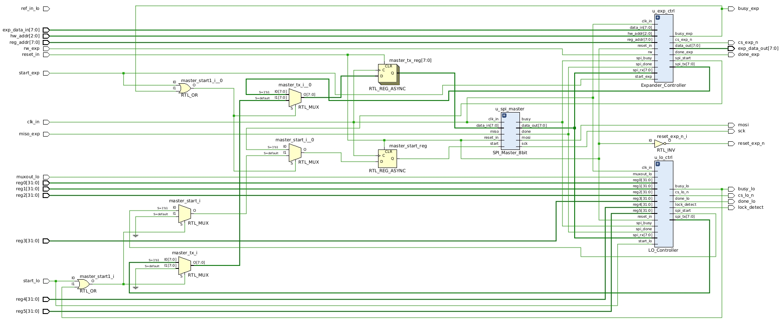
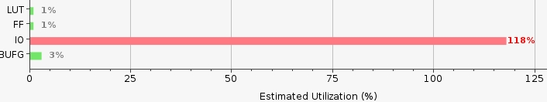
Not an I/O
- Converting to an internal process
FPGA to Front-End Control [E] [P2.5]
Notes:
Go over SOW/ what we are doing for project

Slide 12
FPGA to Computer Communication
Using Eclypse Z7 Notes repository (recommended by Digilent)
FPGA will run custom Alpine Linux
The source code is written in Verilog and C
Next steps are controlling PMOD from GNU Radio
Notes:
Go over SOW/ what we are doing for project

Slide 13
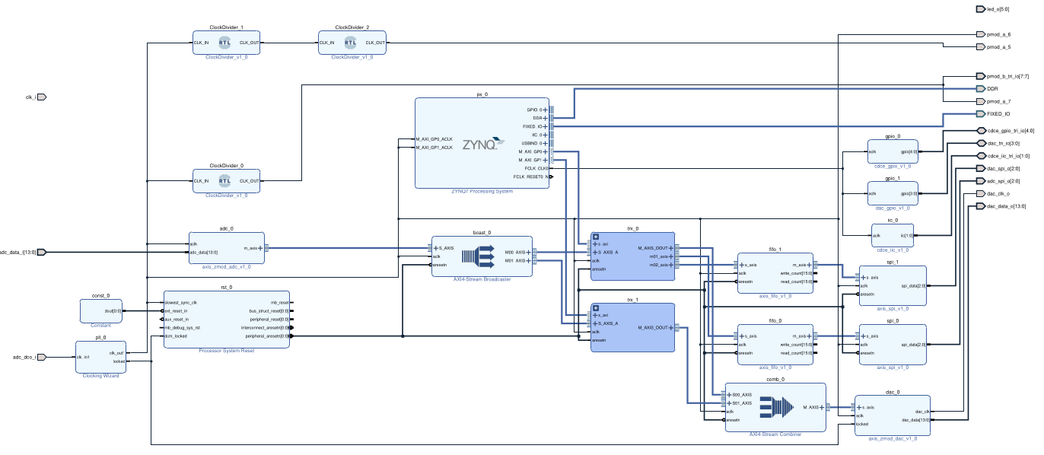
Eclypse Z7 SDR Transceiver Clock Block Diagram [M]
Notes:
Go over SOW/ what we are doing for project

Slide 14
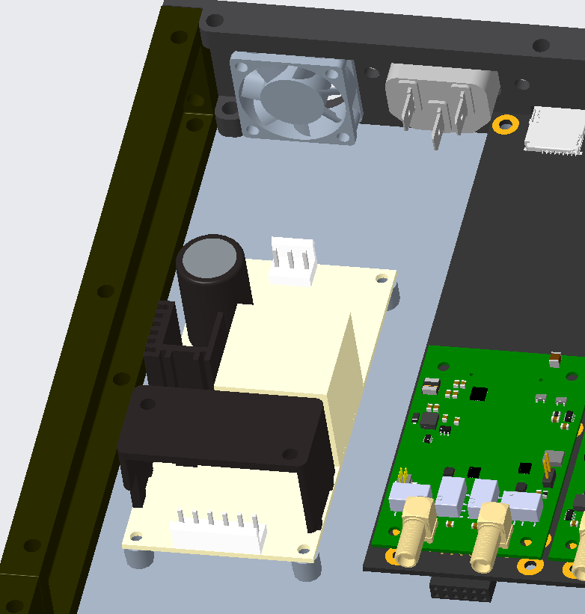
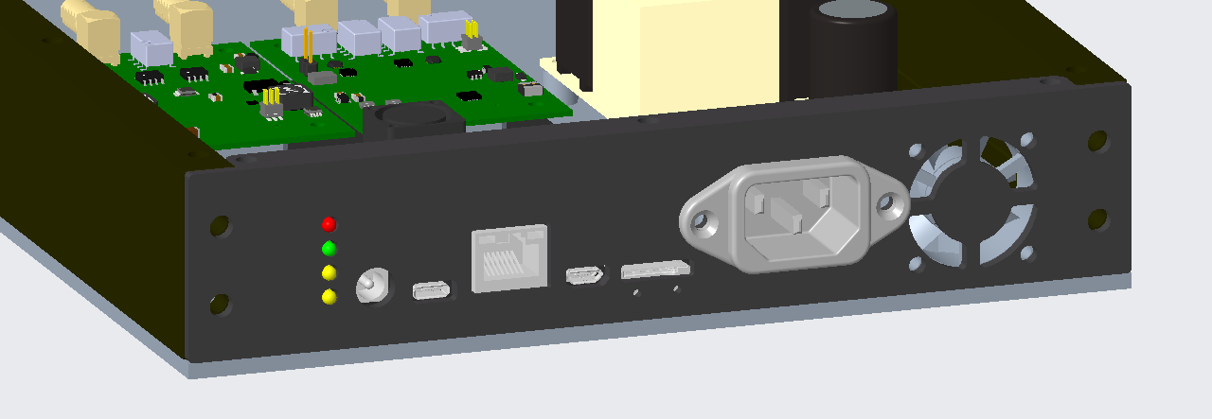
Enclosure Changes [I] [P1.5]
Power Supply/Receptacle
Base Plate & lid - 8x16in
updated wall dimensions
Fan - Adafruit 30x30x8mm - 5 VD
Notes:
Go over SOW/ what we are doing for project

Slide 15
Risk Mitigation
We only have one chance at getting the PCB to work, Jed, Steve and Andrew N are reviewing Nathans PCB Schematics and Jed is actively helping in designing the layout.
There is still a lot of work to be done on the computer side, to help with that Nathan moved Andrew N over to computer work to help Andrew B where needed. Moved Steve over to PCB Layout to help Nathan.
The time left to assemble the enclosure and mount our components inside is running out. Once the PCB is ordered Nathan will be focused on helping Alan with the enclosure if needed.
Notes:
Go over SOW/ what we are doing for project

Slide 16

Questions?

Slide 17
Appendix
[A]
Title: Statement of Work (SOW)
Author: QORVO_RADIO Design Team
Description: Finalized objectives and deliverables
File: QORVO_RADIO_PerformanceSpec_and_SOW.docx
File Location: SD2_QORVO_RADIO_S25>Reports and Documents>PROJECT MANAGEMENT>QORVO_RADIO_SOW.docx
[B]
Title: Updated Project Plan
Author: Nathan Waters and Alan Lucke
Description: Timeline and key milestones
File: QORVO_RADIO_Plan_RevA.xlsx
File Location:SD2_QORVO_RADIO_S25>Reports and Documents>QORVO_RADIO_Plan_RevA.xlsx
[C]
Title: Schematic
Author: Nathan Waters
Description: Schematic for PCB
File: QORVO_RADIO_PCB.PDF
File Location: SD2_QORVO_RADIO_S25>DRAWINGS>PCB>COMPONENTS>SCHEMATICS
[D]
Title: Updated Block Diagram
Author: Nathan Waters
Description: System architecture overview
File: QORVO_RADIO_PCB.PDF
File Location: SD2_QORVO_RADIO_S25>DRAWINGS>PCB>COMPONENTS>SCHEMATICS
[E]
Title: FPGA to Front-End Control
Author: Steven Freinstein
Description: Block Diagram for SPI Communication
File: FPGAInterconnectsDiagram.png
File Location: SD2_QORVO_RADIO_S25>Research>Computer>
WorkDocs_Steven>FPGAInterconnectsDiagram.png

Slide 18
Appendix
[G]
Title: Abstracted Data Path
Author: Andrew Bowman
Description: Path from PC to RF Front end
File: Qorvo_F24_SD/Computer/EclypseZ7_rev0-Copy of Hardware.drawio.png at main · Eskdagoat/Qorvo_F24_SD
File Location:
[H]
Title: I/O Expander
Author: Steve Frienstien/Texas Instruments
Description: I/O Expander
File: MCP23017_Data_Sheet_DS20001952-2998473.pdf
File Location: SD2_QORVO_RADIO_S25>DRAWINGS>PCB>COMPONENTS>MCP23017_Data_Sheet_DS20001952-2998473.pdf
[I]
Title: Updated Enclosure Model
Author: Alan Lucke
Description: CREO 3D model of Enclosure
File: UPDATED_ENCLOSURE
File Location: SD2_QORVO_RADIO_S25>DRAWINGS>ENCLOSURE>UPDATED_ENCLOSURE.PNG
[J]
Title: QORVO_RADIO_PR3
Author: Alan Luecke and Nathan Waters
Description: Purchase Order for Amazon
File: QORVO_RADIO_PR3
File Location: SD2_QORVO_RADIO_S25>BILL OF MATERIALS AND BUDGET>PURCHASE ORDER>QORVO_RADIO_PR4
[K]
Title: QORVO_RADIO_PR4
Author: Alan Luecke and Nathan Waters
Description: Purchase Order for DigiKey
File: QORVO_RADIO_PR4
File Location: SD2_QORVO_RADIO_S25>BILL OF MATERIALS AND BUDGET>PURCHASE ORDER>QORVO_RADIO_PR4
[L]
Title: Task Management
Author: Nathan Waters
Description: To-Do List for SD2
File: Task Management
File Location: SD2_QORVO_RADIO_S25>Reports and Documents>PROJECT MANAGEMENT>TASK MANAGEMENT

Slide 19
Appendix
[M]
Title: Eclypse Z7 SDR Transceiver Clock Block Diagram
Author: Andrew Bowman
Description: Eclypse Z7 SDR Transceiver Clock Block Diagram
File: Qorvo_F24_SD/SD2_Spring25/Computer/ez7n_sdr_transceiver_with_clock.pdf at main · Eskdagoat/Qorvo_F24_SD
File Location:

